Slide 1
Predict Customer response over credit card
Created By: Anubhav
Last Updated: 30 May 2021

Slide 2
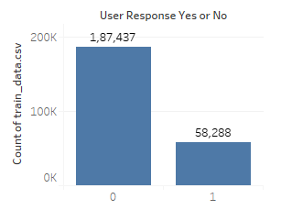
Problem Statement and Dataset Overview
Based on the given dataset predict whether will give positive or negative response to Credit Card offer.
The given dataset is more biased towards User whose response going to be negative
In the given chart, 0 means No and 1 means Yes

Slide 3
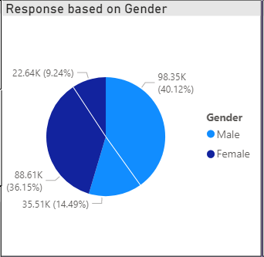
Response Based on GENDER
We have more Male Customer in our bank
There are more chance that Male customer will response positively over Female customer

Slide 4
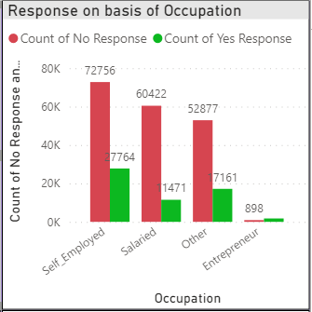
Response Based on occupation
We have lot of customer whose occupation is Self-Employed.
As number of Self-Employed is more so there are lot of user who can give positive response
Surprisingly customer with Other as occupation are tends to be more interested than salaried customer

Slide 5
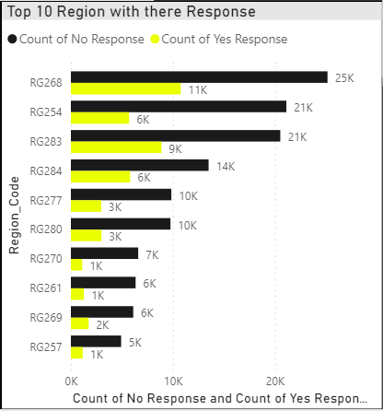
Response Based on Region
RD268, RG254, RG284 and RG283 are contributing around 50% of customer.
There are high chance of getting more customer from these region.
RG277 and RG280 showing good potential as well.
Rest other region tends to be more similar and having less interest in our product.

Slide 6
suggestion to attract more customer
Gender is not playing vital role in our sale but still we need to tell about benefit more to female
We have good number of Salaried customer, they look less interested in our product.
From region RD268, RG254, RG284 and RG283, we have good response. Still we can reach out to more customer because getting positive response from these region is high.
In RG277 and RG280 region we need to advertise more as they are showing good potential.
For rest region, chances are very low so we need more effort in those region

Slide 7
THANK YOU

